Slide 1


Rajarambapu Institute of Technology
K.E.Society’s
(An Autonomous Institute)
Rajaram Nagar, Sakharale
Computer Science & Information Technology Department
CAPSTONE PROJECT
Group Members
Project Guide
Ms. Sneha Davari 1804022
Mr. Siddhant Vakhariya 1804032
Mr. Akash Patil 1804036
Mr. Shidhanath Chavan 1804039
Prof. Mrs. J. A. Patil

Slide 2

“Intelligence System For Personality Assessment From Video Interview”
SYNOPSIS PRESENTATION

Slide 3
CONTENT
1
Introduction
2
Problem Statement
3
Objective
4
Literature Survey
5
Modules
6
System Architecture
7
System Requirements
8
Outcomes

Slide 4
INTRODUCTION
People’s spend more time on social media in daily life, so to recruit the candidate organizations post’s job advertisements on that.
From a lot applicants to choose perfect candidate to respective position has become a challenge to HR, Also there exists a chance of human cognitive biases.
Inviting every job candidate to attend face-to-face interviews is not cost effective for organization, asynchronous video interview (AVI) has been developed as an alternative.
AI in recruitment is relatively a new topic and research is being done to assess the advantages and challenges of using AI in recruitment and selection.

Slide 5
Assess the personality and skills of candidates during the online interview for respective job profile.
PROBLEM STATEMENT

Slide 6
1
To reduce the time to hire employee and save organization’s money.
2
To speed up the screening process of hiring employee.
3
To make unbiased standard assessments of candidate.
OBJECTIVES

Slide 7
LITERATURE SURVEY
Research paper no. | Problem solved | Verbal | Non-verbal | Methodology
[1] | Automatic prediction of hirability | - | Yes | Regression Methods
[2] | Automatic prediction of rating to interviewees | - | Yes | 16 Regression Models
[3] | Assessment of psychological and personality traits | Yes | Yes | CNN
[4] | Job analysis based on behavioural description | Yes | Yes | KSAO’s identification technique
[5] | Automated personality Assessment by Video interview | Yes | Yes | Machine learning, Nomological network

Slide 8
Capturing Module
Video-Procesing & Feature Extraction Module
MODULES
Classification Module
Output Module

Slide 9
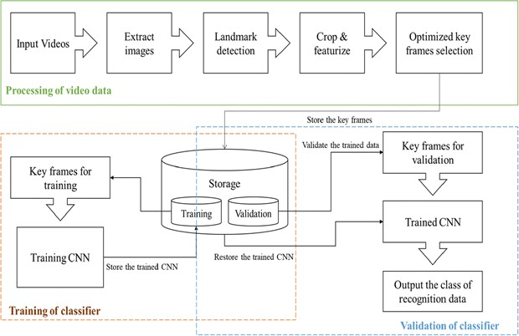
SYSTEM ARCHITECTURE

Slide 10


HARDWARE
SOFTWARE
R E Q U I R E M E N T S
i5 Processor Based Computer or higher
Memory : 8 GB RAM Hard Drive : 256 GB Internet Connection Web Cam
SSD : 256 GB
Windows 7 or Higher Anaconda
Visual Studio 19
2GB Graphics Card
S Y S T E M

Slide 11
Orgnization can select best candidate as per their requirement
Save money & time of organization’s for hiring process
Helps to make better preparation of candidates for interviews
Make personality judgement of candidate
PROJECT OUTCOMES

Slide 12

Thank You

